Slide 1
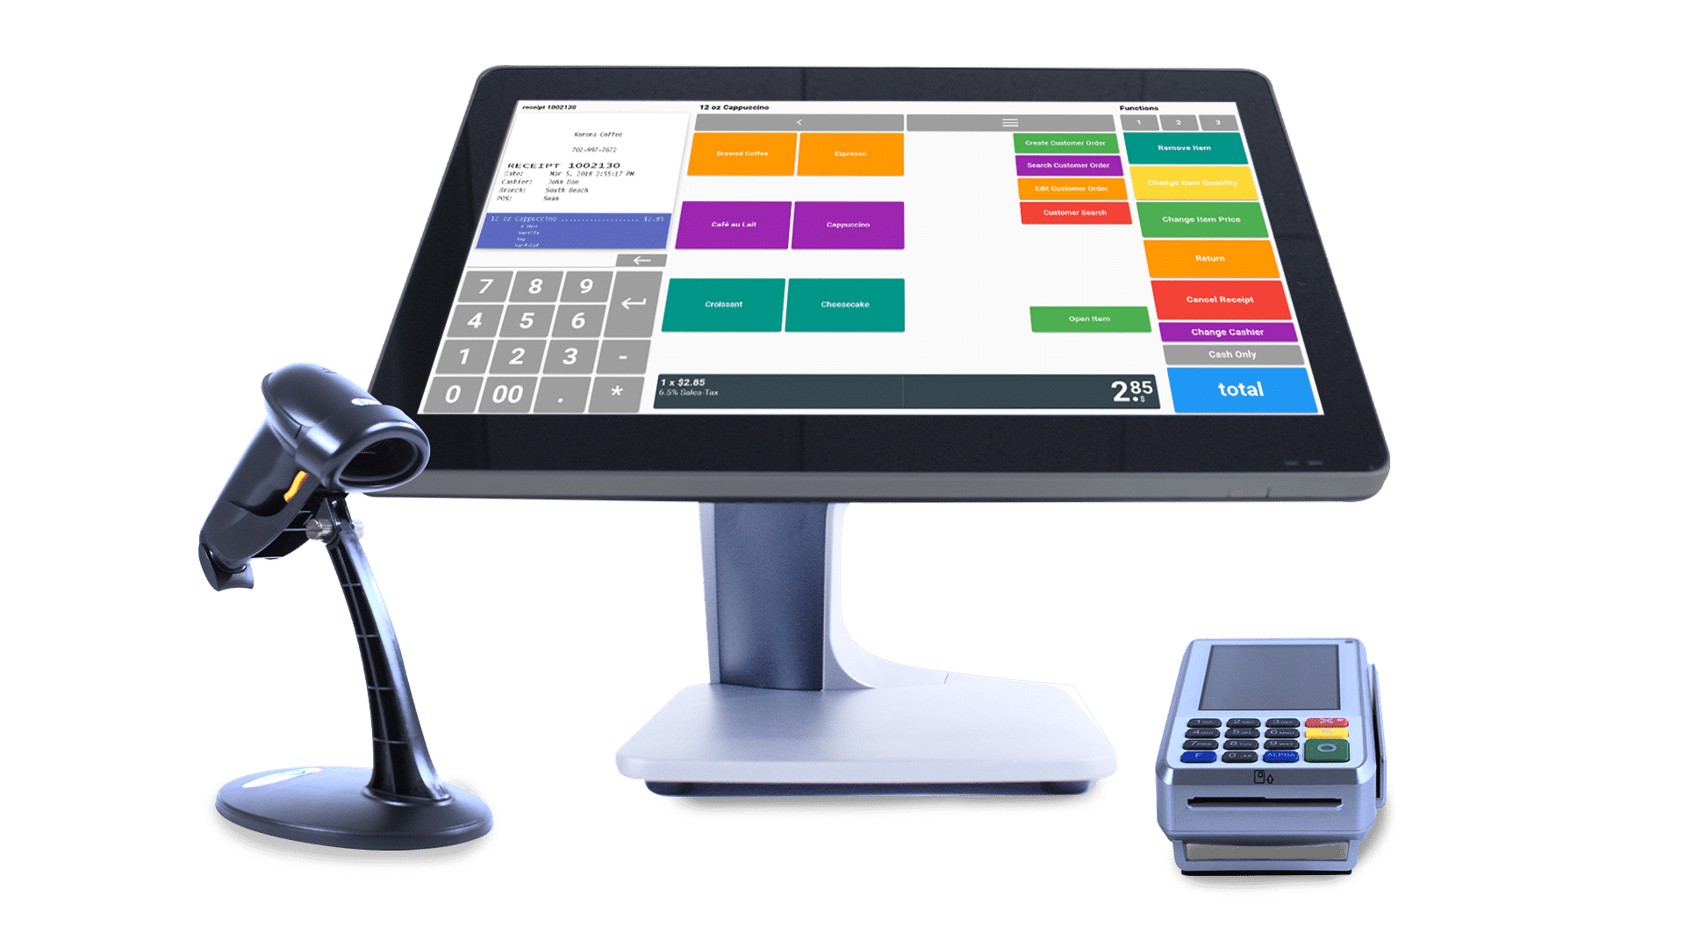
WE-POS Jira Presentation
Presenters
Team-2

Slide 2
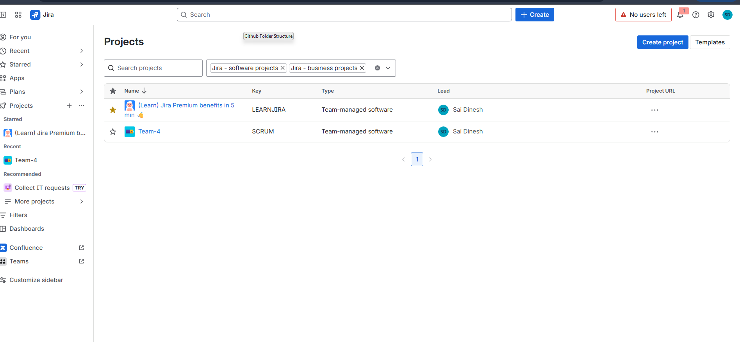
JIRA The project site on the Atlassian Jira application is named as “WE-POS” a team-managed project on JIRA.

Slide 3
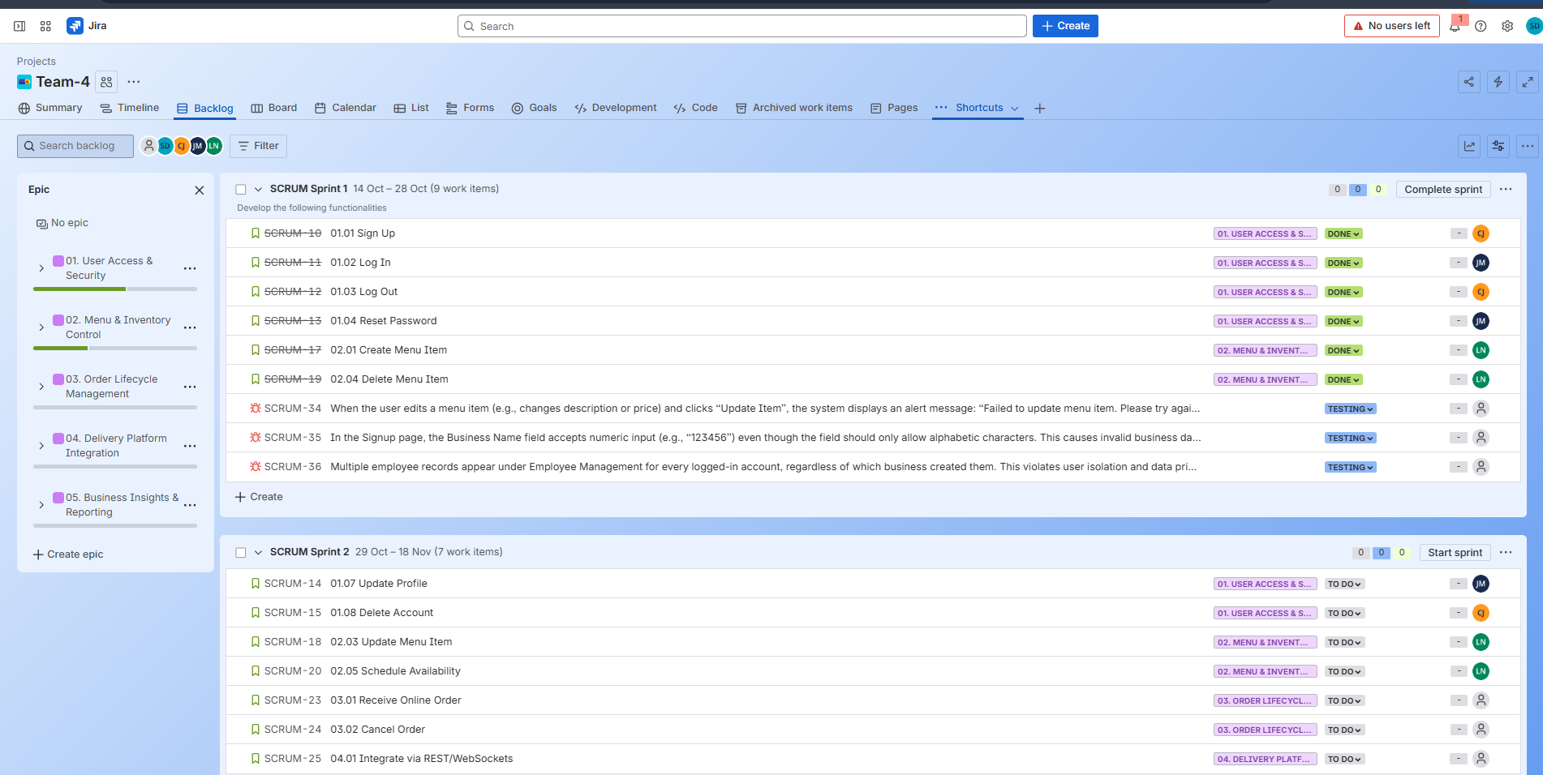
Epics and User Stories on JIRA

Slide 4
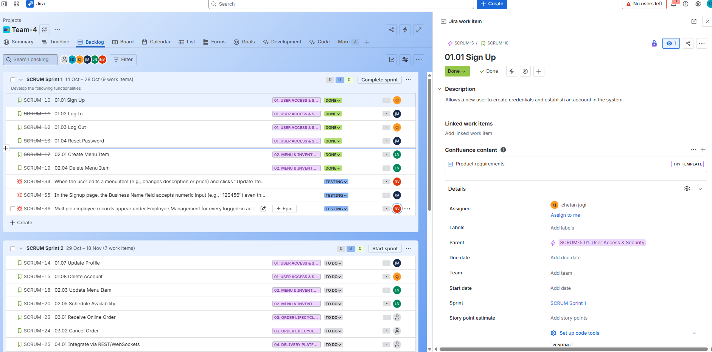
User Stories on JIRA

Slide 5
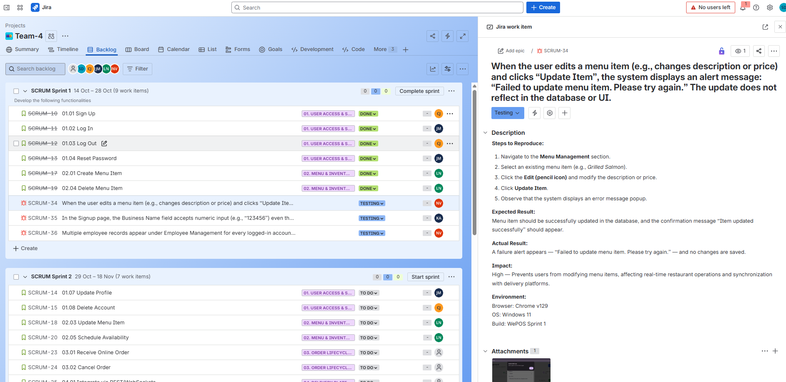
Defects on JIRA

Slide 6
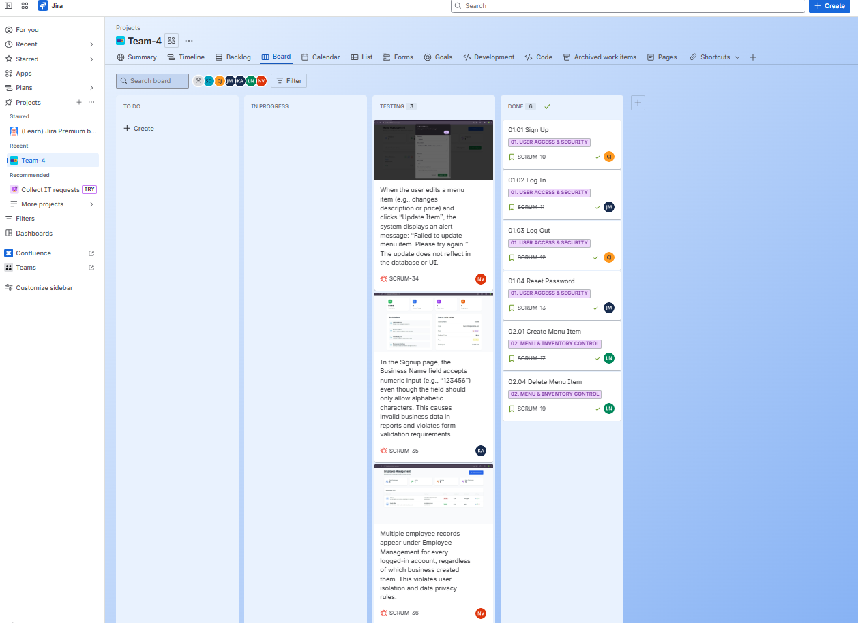
Kanban Board on JIRA

Slide 7




Thank you

